Slide 1
jQuery Mobile
A touch-optimised mobile framework.

Slide 2
Role of a framework:
A javascript framework is a platform for developing web or mobile applications.
Frameworks were designed to bring structure and organisation to JavaScript code.
A framework gives you access to a library of pre-written javaScript files which saves development time.

Slide 3
About jQuery Mobile
jQuery Mobile framework was built on top of the jQuery library.
Can be used with Phone Gap to access native features like camera.
Enables the developer to create touch-friendly web sites that work across a wide range of browsers and devices.
jQuery Mobile was developed to prioritize mobile design first but not just exclusively for mobile web so it can be used as a base for responsive design.

Slide 4
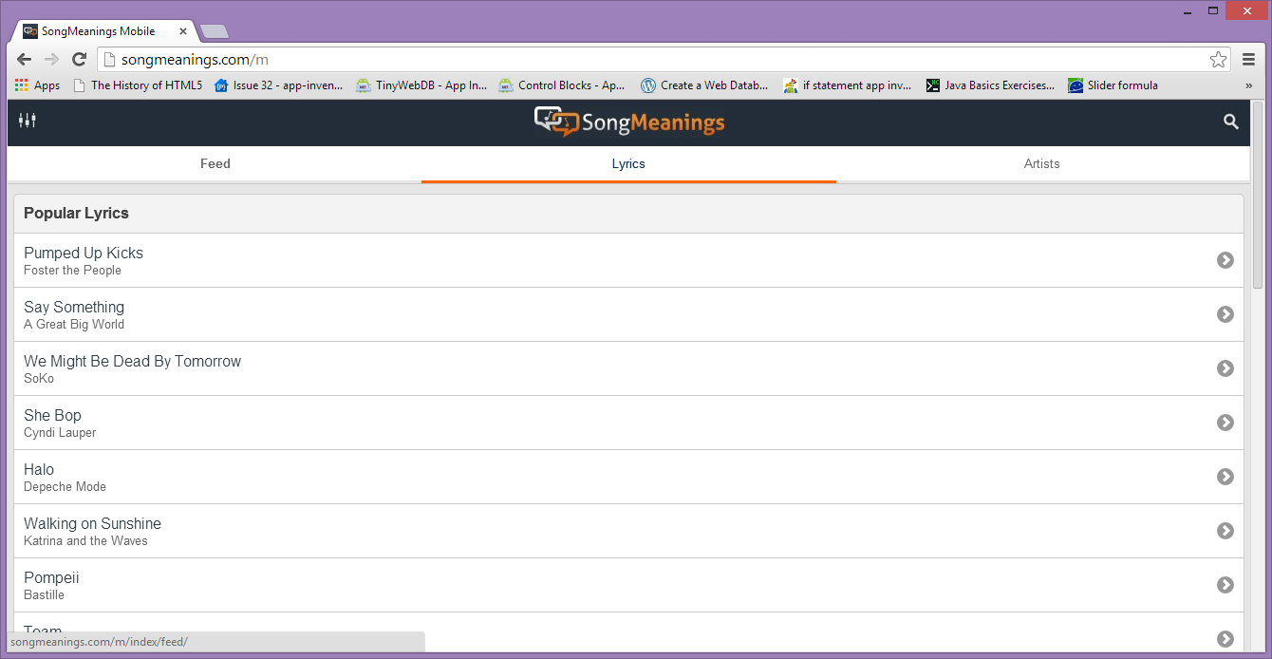
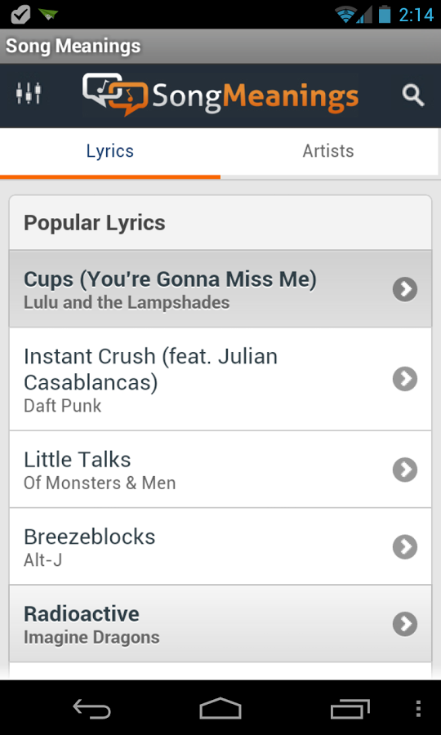
Example of jQM usage in mobile/desktop environment

Slide 5
Features of jQuery Mobile
It is also the only major UI framework that uses progressive enhancement, where it delivers basic html to devices that can’t handle CSS or Ajax.
jQuery Mobile adapts to work with less capable browsers by switching off features of a web page so that the site is still functional.
jQuery Mobile also features an application called theme Roller which helps the developer build a custom theme for visual components such as buttons and widgets.

Slide 6
Limitations of jQuery Mobile
jQuery Mobile and HTML5 are more suited to simple content display and data entry-type apps at the moment.
The CSS styling theme system has limited options so sites built using this can look similar.
Slower Than Native
The framework is relatively new so issues still exist.

Slide 7
Examples of usage
The framework includes a set of six CSS-based page transition effects, which can be applied to any object or page change event.
Example:
//transition to the "about us" page with a slideup transition
$.mobile.changePage( "about/us.html", { transition: "slideup"} );

Slide 8
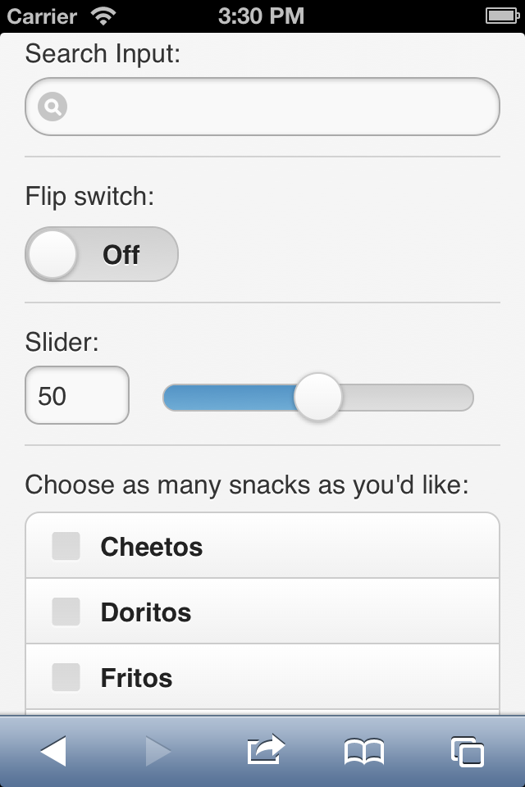
Examples of usage
jQuery Mobile supports standard Web form controls and the new mobile controls in the same form. The framework has a feature called “auto-initialization” that replaces every Web form control with a touch-friendly control. This is an example of how jQuery Mobile renders a form.

Slide 9
Other frameworks
Twitter Bootstrap:
Bootstrap easily and efficiently scales your project with one code base, from phones to tablets to desktops.
Bootstrap is open source. It's hosted, developed, and maintained on GitHub.
Sencha Touch:
A Mobile UI Framework that requires that all UI code is written in JavaScript.
Sencha Touch supports Apache Cordova APIs for Accelerometer, Camera and other native features.

